Slide 1
Project 2 – Data Visualisation Group 8 (Ben, Zach, Namita)
The Animal Inhabitants of
U.S. National Parks

Slide 2
Planning a trip to observe animals in their natural habitat?
Tourists can use these customisable maps to find
U.S. National Parks
Animals found in these parks

Slide 3
Technical Design
The process we followed for – 1. Data creation and storage
Obtaining and Storing Data
Web scraping was used to create parks data frames and load in the postgres parks table
Animal data was taken from national park service and loaded in the postgres database.

Slide 4
Technical Design
The process we followed for – 2. Data Visualisations
Creating the app
Created the app through flask API to render all the templates - index, parks and animals webpages
Connected to postgres db to fetch parks and animal data
Rendered the maps and markers through JS libraries

Slide 5
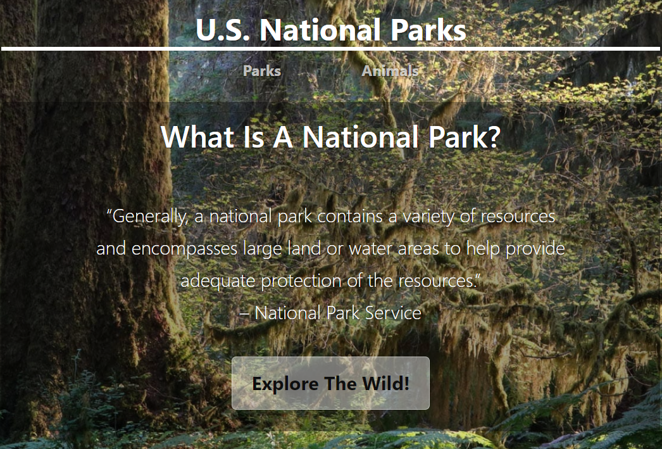
Landing Page
Navigate to
Parks page
Animals page
“Explore the Wild” button will also navigate to the Parks page.

Slide 6
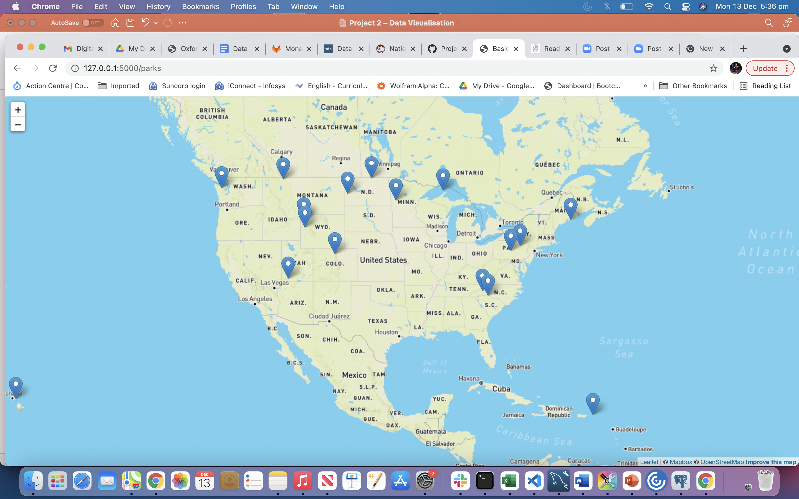
Map Page 1
The “Parks” page marks a number of the US national parks that we have animal location data for.

Slide 7
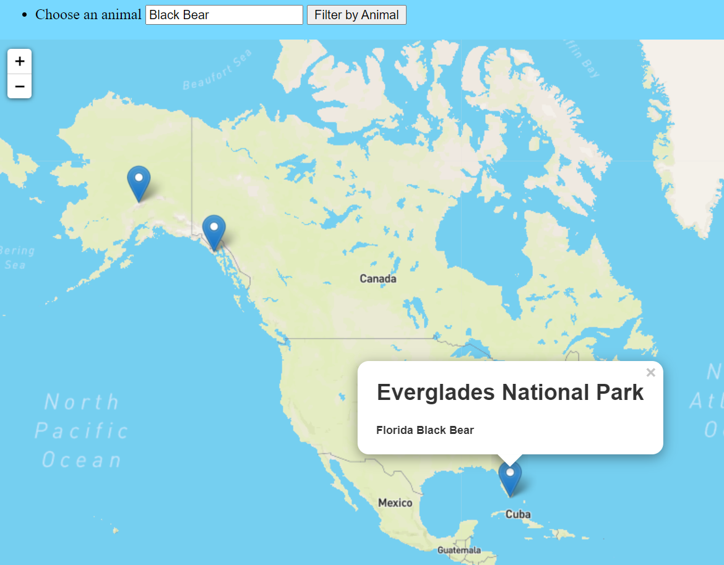
Map Page 2
The “Animals” page allows you to search by animal type. Search results will print markers on the map showing which parks this animal can be found in.

Slide 8
Limitations
Complications with connecting to the database,
Trying to use a library of animal svgs
Not enough time to go through all the National parks, limited to Birds and Mammals to handle the data
Limitations due to capacity

Slide 9
Data and Map Sources
https://irma.nps.gov/NPSpecies/Search/SpeciesList/ACAD
https://www.latlong.net/category/national-parks-236-42.html
https://www.mapbox.com/about/maps/
https://openweathermap.org/api/statistics-api#geo-month

